Slide 1
Results for Calculus Based Courses

Slide 2
Assumption Checking

Slide 3
Alg
Pretest Residual
Pretest Standard Residual
Pretest Residual
Fitted
Courses
Standard Normal Quantiles
Posttest Residual
Posttest Standard Residual
Posttest Residual
Fitted
Courses
Standard Normal Quantiles

Slide 4
calc
Pretest Residual
Pretest Standard Residual
Pretest Residual
Fitted
Courses
Standard Normal Quantiles
Posttest Residual
Posttest Standard Residual
Posttest Residual
Fitted
Courses
Standard Normal Quantiles

Slide 5
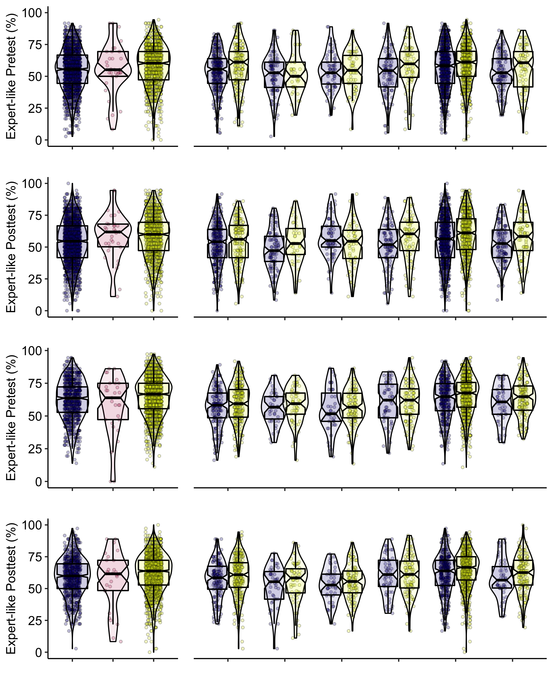
Algebra-based Courses
Women
Gender
Other
Men
Asian
Black
Hispanic
Race
Other
White
White
Hispanic
Women
Gender
Other
Men
Asian
Black
Hispanic
Race
Other
White
White
Hispanic
Calculus-based Courses
Men
Hispanic
Race
Other
White
Women
Gender
Other
Asian
Black
White
Hispanic
Women
Gender
Other
Men
Asian
Black
Hispanic
Race
Other
White
White
Hispanic

Slide 6
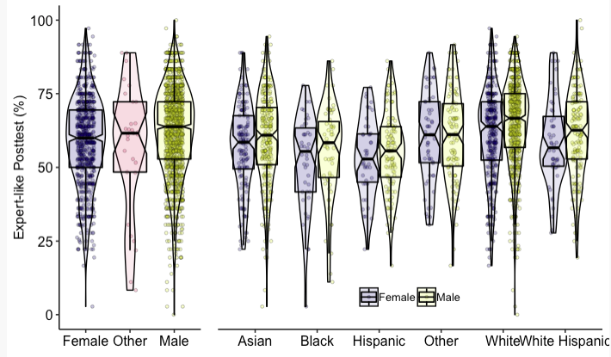
Descriptive Statistics – See next slide
Need to fix WhiteHispanic

Slide 7
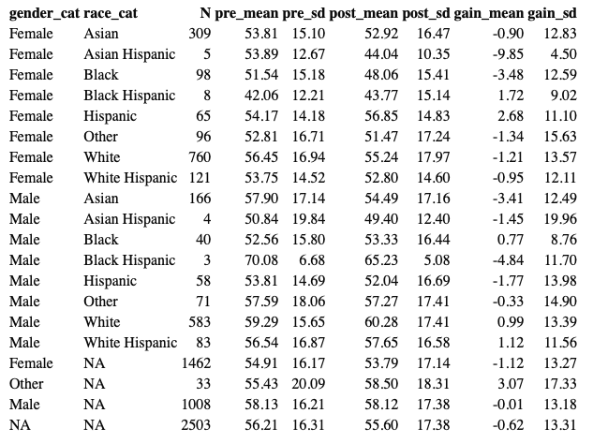
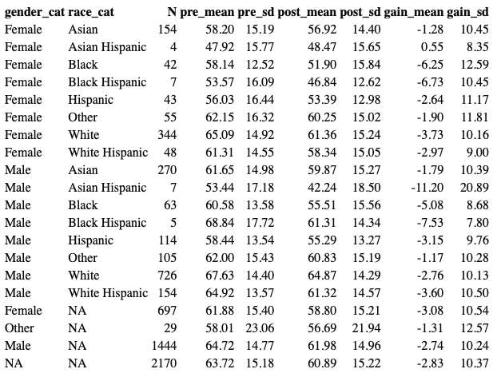
Descriptive statistics tables
Algebra based
Calculus based

Slide 8
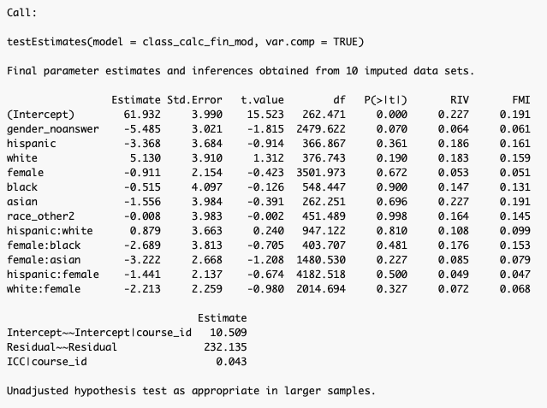
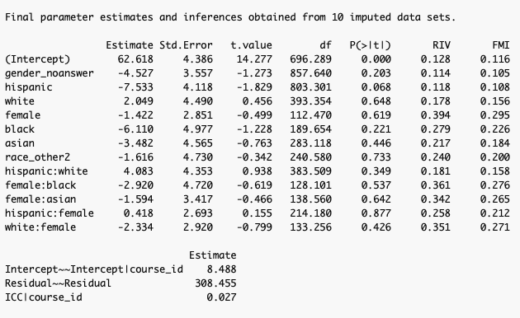
Models
Pre
Post

Slide 9
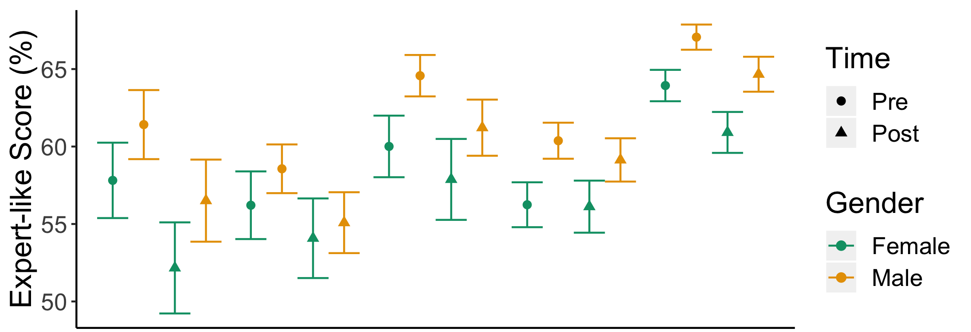
Black
Hispanic
White
Hispanic
Asian
White
Drop for black students worth talking about.
I need to think about putting the Alg and Calc figures on the same axes

Slide 10
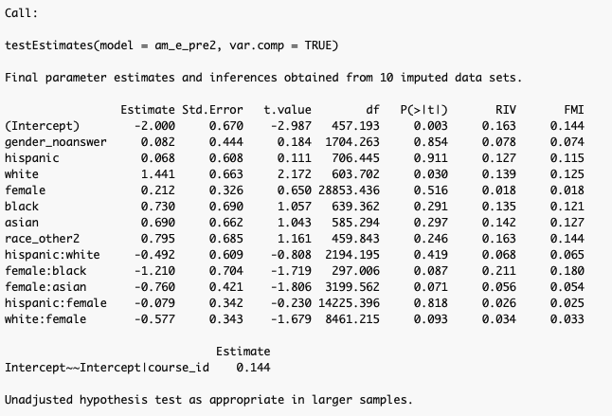
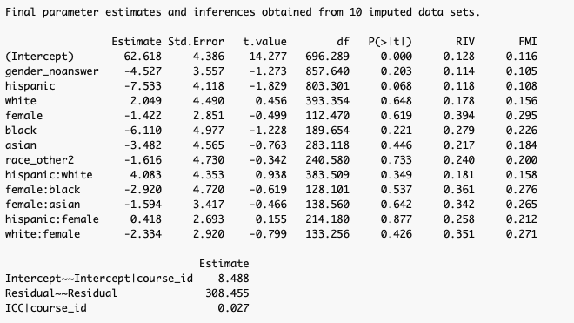
Prob of >75% models

Slide 11
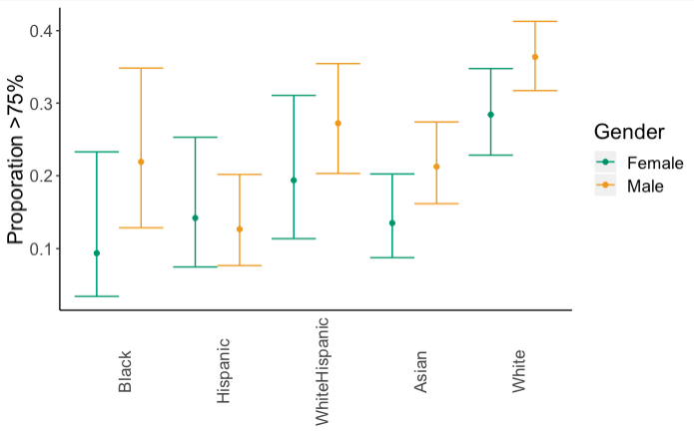
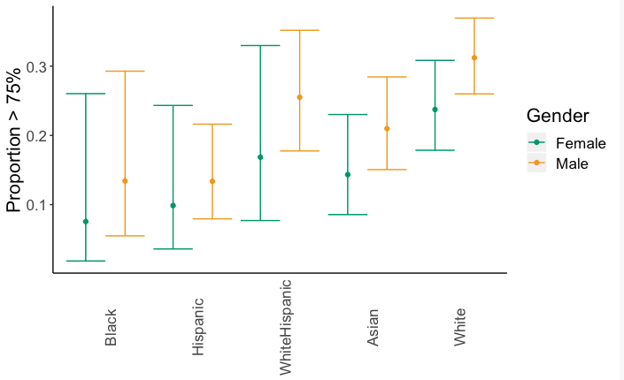
Proportion >75% on pre and post
Smaller standard errors on the pretest because of far less missing data.

Slide 12
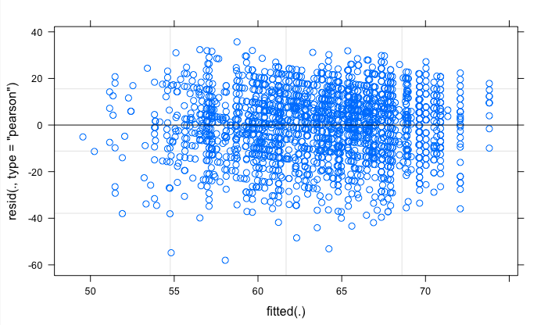
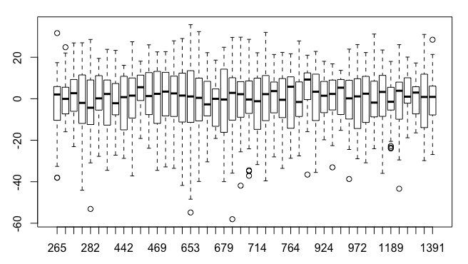
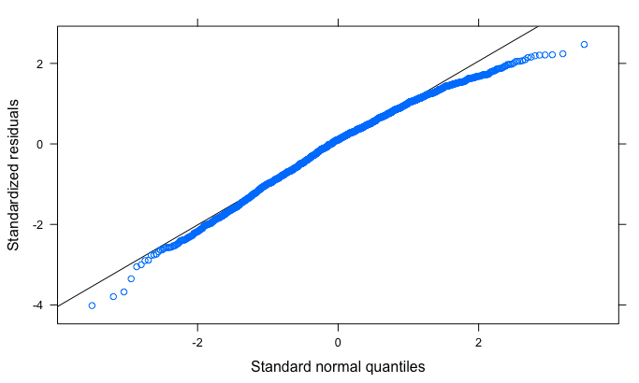
Assumption Checking for pretest
No correlations between the residuals and the predictor variables.
﻿A visual check of the three assumptions of HLM model 3 from the first MI dataset. (a) Assumption of linearity—A plot of residuals vs fitted values. A random distribution of sample points indicated the model met the assumption of linearity. (b) Assumption of homogeneity of variance—A boxplot of residuals by course. Consistent medians and interquartile ranges indicated the model met the assumption of homogeneity of variance. This assumption was further verified quantitatively using an ANOVA. (c) Assumption of normality—A quantile-quantile plot of the observed and expected values. The points falling close to the line indicated that the model met the assumption of normality.
The negative curvature indicates a small left skew in the data. There are more far negative residuals than would be expected if they were normally distributed, though this skew looks relatively small in the qqplot. The residual is the difference between the observed value and the predicted value. This indicates that the model tends to slightly underpredict the observed scores.This likely occurs because the data, as shown in the violin plots tends to have a slight left (down) skew. Hence the model is overdriven by lower test scores. The effect of this small violation of the assumption will be larger for groups with higher predicted scores. This will have a conservative effect on our results as it will compress the differences across demographic groups. [Does this sound good?]

Slide 13
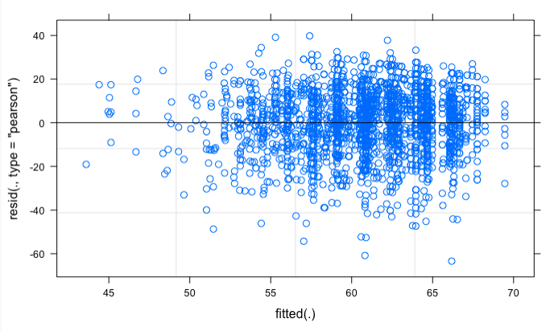
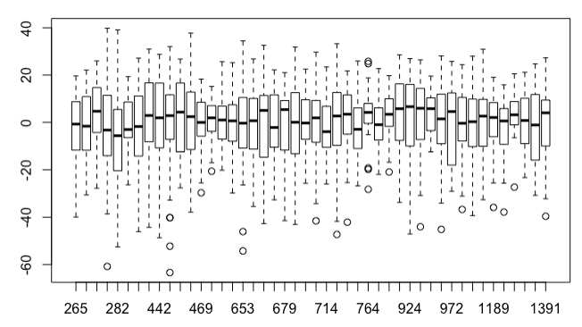
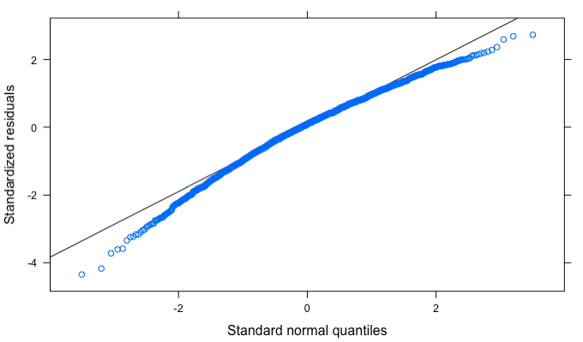
Assumption Checking for posttest
No correlations between the residuals and the predictor variables.
﻿A visual check of the three assumptions of HLM model 3 from the first MI dataset. (a) Assumption of linearity—A plot of residuals vs fitted values. A random distribution of sample points indicated the model met the assumption of linearity. (b) Assumption of homogeneity of variance—A boxplot of residuals by course. Consistent medians and interquartile ranges indicated the model met the assumption of homogeneity of variance. This assumption was further verified quantitatively using an ANOVA. (c) Assumption of normality—A quantile-quantile plot of the observed and expected values. The points falling close to the line indicated that the model met the assumption of normality.
The negative curvature indicates a small left skew in the data. There are more far negative residuals than would be expected if they were normally distributed, though this skew looks relatively small in the qqplot. The residual is the difference between the observed value and the predicted value. This indicates that the model tends to slightly underpredict the observed scores.This likely occurs because the data, as shown in the violin plots tends to have a slight left (down) skew. Hence the model is overdriven by lower test scores. The effect of this small violation of the assumption will be larger for groups with higher predicted scores. This will have a conservative effect on our results as it will compress the differences across demographic groups. [Does this sound good?]

Slide 14
Results for Algebra Based Courses

Slide 15
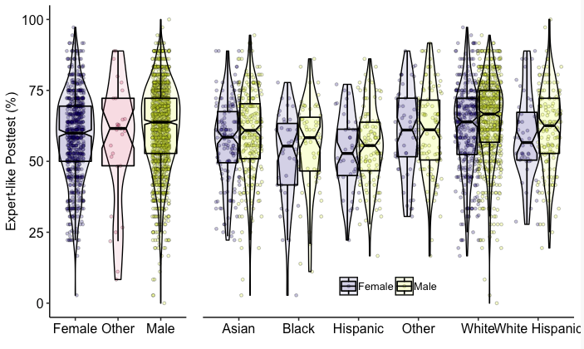
Descriptive Statistics
Need to fix WhiteHispanic

Slide 16
Descriptive statistics tables

Slide 17
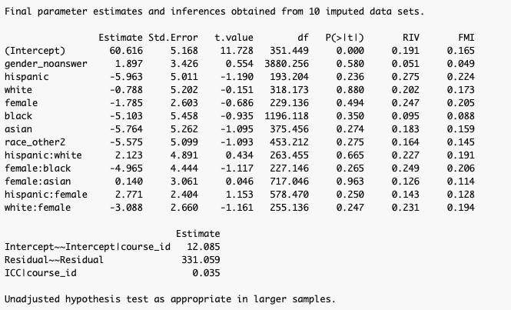
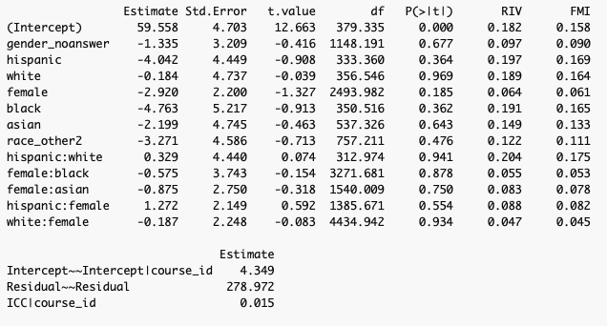
Models
Pre
Post

Slide 18
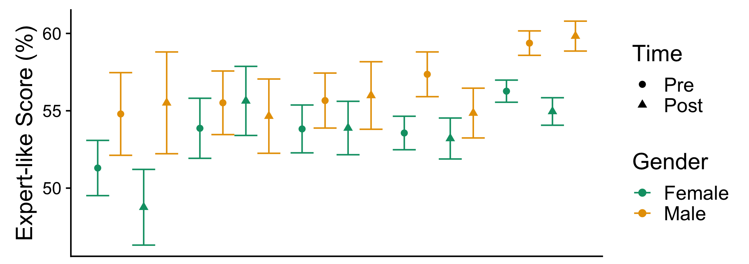
Algebra
Black
Hispanic
White
Hispanic
Asian
White

Slide 19
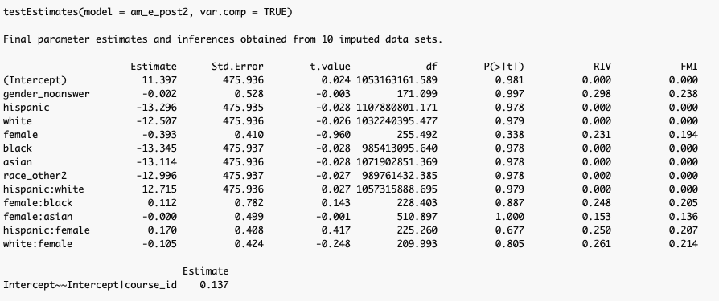
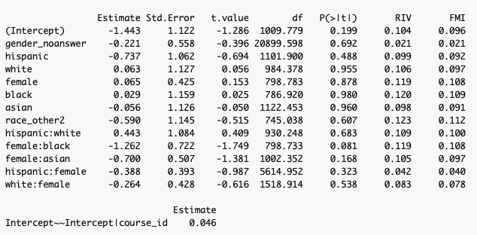
Prob of >75% models
Something very wrong with the posttest. I think it may be because there are too few samples for the model to run. I’m not sure.
The posttest is failing to converge because there are several courses with no one over 75% or only one person over 75%, which means that most of the demographic groups have no one over 75% in lots of courses. This leaves too little variance at the course level for the models to work with. The models work if I cut the threshold down to 50%, but then it is kinda meaningless. It might also be an issue that the Black Hispanic and Asian Hispanic groups have no one over 75 on the posttest. I’m not sure how those interactions affect the model. But if the results should be small for Black, Hispanic, and Asian but zero when they are added that seems like it would cause a problem.

Slide 20
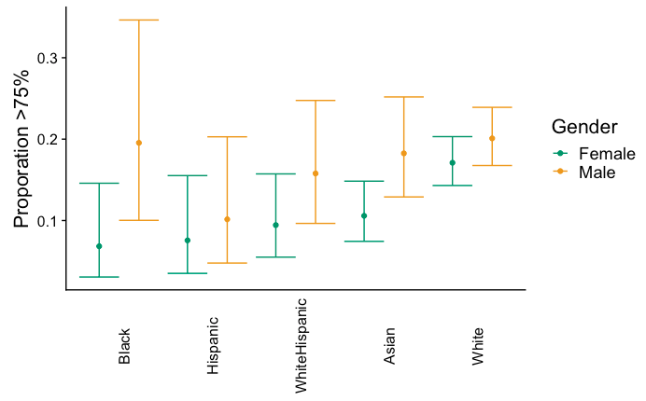
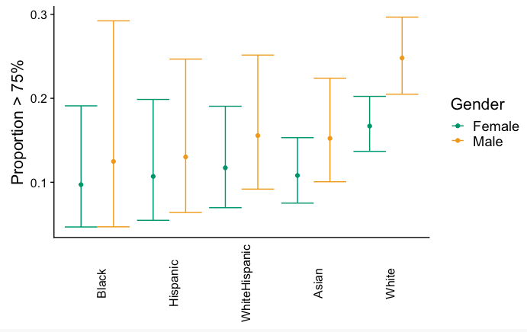
Proportion >75% on pre and post
Smaller standard errors on the pretest because of far less missing data.

Slide 21
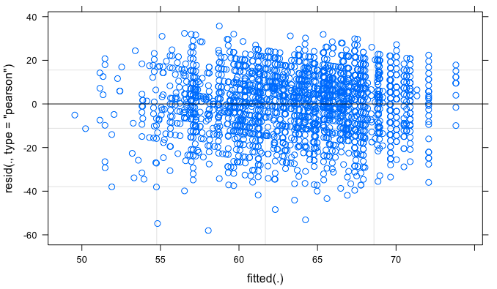
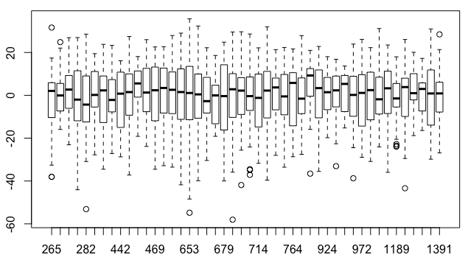
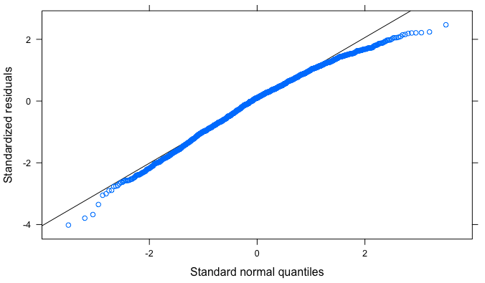
Assumption Checking for pretest
No correlations between the residuals and the predictor variables.
﻿A visual check of the three assumptions of HLM model 3 from the first MI dataset. (a) Assumption of linearity—A plot of residuals vs fitted values. A random distribution of sample points indicated the model met the assumption of linearity. (b) Assumption of homogeneity of variance—A boxplot of residuals by course. Consistent medians and interquartile ranges indicated the model met the assumption of homogeneity of variance. This assumption was further verified quantitatively using an ANOVA. (c) Assumption of normality—A quantile-quantile plot of the observed and expected values. The points falling close to the line indicated that the model met the assumption of normality.
The negative curvature indicates a small left skew in the data. There are more far negative residuals than would be expected if they were normally distributed, though this skew looks relatively small in the qqplot. The residual is the difference between the observed value and the predicted value. This indicates that the model tends to slightly underpredict the observed scores.This likely occurs because the data, as shown in the violin plots tends to have a slight left (down) skew. Hence the model is overdriven by lower test scores. The effect of this small violation of the assumption will be larger for groups with higher predicted scores. This will have a conservative effect on our results as it will compress the differences across demographic groups. [Does this sound good?]

Slide 22
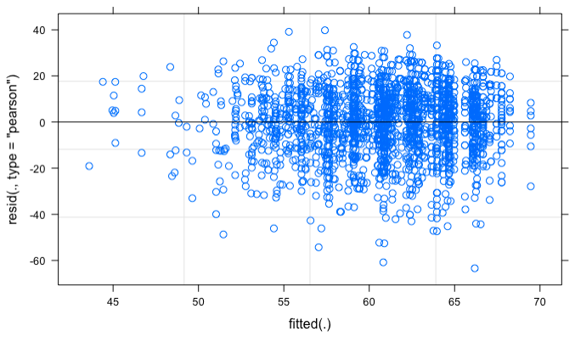
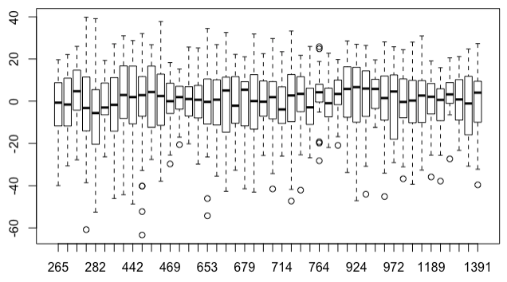
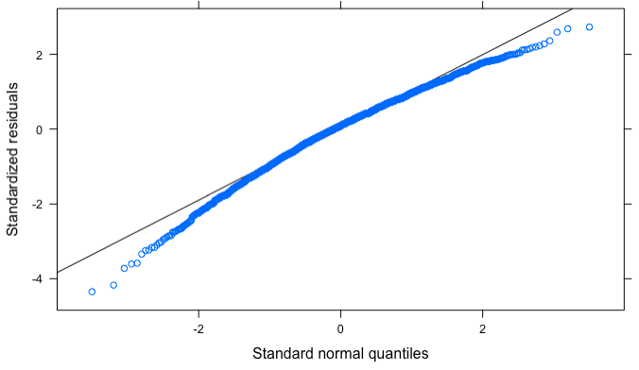
Assumption Checking for posttest
No correlations between the residuals and the predictor variables.
﻿A visual check of the three assumptions of HLM model 3 from the first MI dataset. (a) Assumption of linearity—A plot of residuals vs fitted values. A random distribution of sample points indicated the model met the assumption of linearity. (b) Assumption of homogeneity of variance—A boxplot of residuals by course. Consistent medians and interquartile ranges indicated the model met the assumption of homogeneity of variance. This assumption was further verified quantitatively using an ANOVA. (c) Assumption of normality—A quantile-quantile plot of the observed and expected values. The points falling close to the line indicated that the model met the assumption of normality.
The negative curvature indicates a small left skew in the data. There are more far negative residuals than would be expected if they were normally distributed, though this skew looks relatively small in the qqplot. The residual is the difference between the observed value and the predicted value. This indicates that the model tends to slightly underpredict the observed scores.This likely occurs because the data, as shown in the violin plots tends to have a slight left (down) skew. Hence the model is overdriven by lower test scores. The effect of this small violation of the assumption will be larger for groups with higher predicted scores. This will have a conservative effect on our results as it will compress the differences across demographic groups. [Does this sound good?]

Slide 23
Old Figures

Slide 24
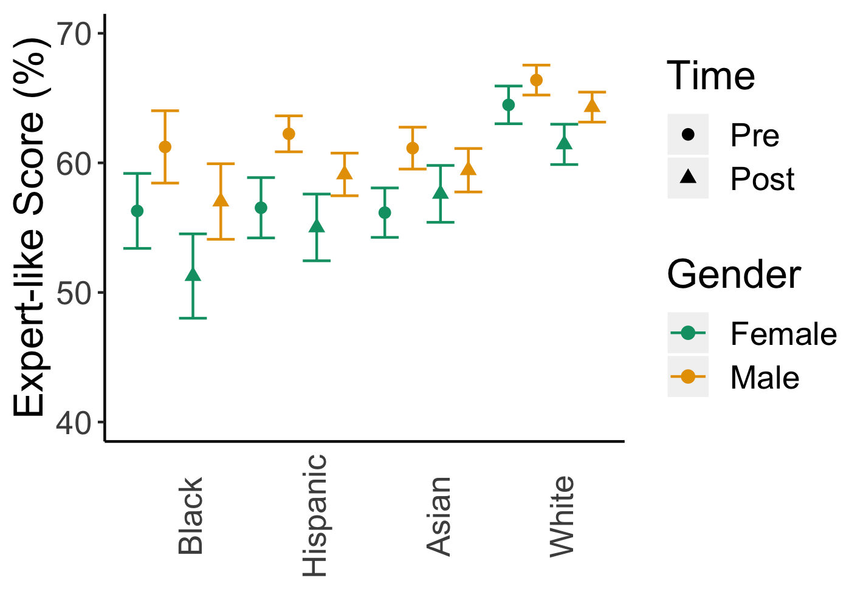

Slide 25
